Slide 1

Unleash Your Website with Amazon S3
Amazon S3 provides world-class security, scalability, and performance, making it the ideal choice for hosting your website. With our guide, you'll learn everything you need to know to get started, from setting up your S3 bucket to configuring bucket permissions and policies. We'll also show you how to upload your website files to S3 and enable static website hosting.

Slide 2

Introduction to Static Website
A static website is a collection of web pages that are delivered to the user exactly as they are stored. Unlike dynamic websites, static websites do not contain server-side processing or database integration. This makes them ideal for hosting on Amazon S3, which excels at securely and efficiently delivering static content to users across the globe.
Static websites are typically built using HTML, CSS, and JavaScript files that can be stored easily on Amazon S3, and delivered using Amazon CloudFront. By combining these services, you can enjoy global content delivery at high speeds. Additionally, the simple architecture of static sites makes them less vulnerable to cyberattacks.

Slide 3

What is AWS?
200+
Popular programming languages
Robust security features
Services for computing, storage, networking, and more
Compliance certifications for data privacy and protection
Java, Python, Json toolkits for easy integration

Slide 4
Know More about S3
What is S3?
Benefits of S3
Use Cases
Amazon S3 is a scalable, highly available, and durable cloud storage service that can be used to store and retrieve any amount of data from anywhere on the web.
Fast, reliable, and secure storage that offers easy management, automatic backups, versioning, encryption, and global accessibility at low costs, with a pay-as-you-go model.
S3 can be used for website hosting, media sharing, backup and archiving, data ingestion, machine learning, analytics, IoT, and more.

Slide 5

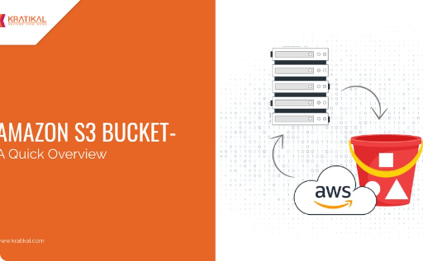
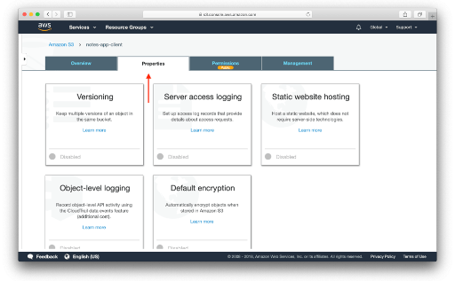
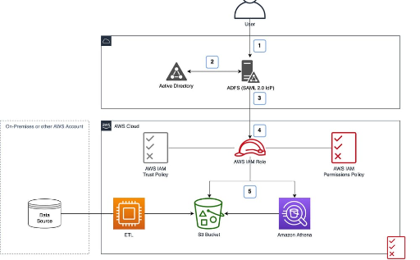
Setting up an S3 Bucket for Website Hosting
Create a Bucket
Configure Properties
Create a Policy
Go to the S3 console and create a new bucket. Choose a unique name, select the region closest to your visitors, and set up logging and versioning according to your needs.
Configure the bucket properties to enable website hosting, set the default error and index documents, and enable redirection if needed. Test the configuration by uploading a sample HTML file.
Create a bucket policy that allows anonymous access to the files in the bucket, while restricting access to the bucket and its contents. Verify that the policy is valid and applies to the right resources.

Slide 6

Configuring Bucket Permissions and Policies
1
Access Control List (ACL)
2
Bucket Policy
Use ACL to grant permissions to individual users, groups, or predefined Amazon S3 groups. ACL defines the operations that are allowed or denied on the objects in the bucket.
Use Bucket Policy to grant permissions to anyone who has access to the Internet. Bucket Policy defines the operations that are allowed or denied on the bucket or its contents.

Slide 7

Uploading Files to S3
1
File Types
Upload your website file to S3 bucket according to their file type. This may include HTML,CSS,JavaScript,images, and other assets.
Permissions
2
Ensure that the files are uploaded with permissions that allow public acces.
3
Web Hosting
Set website hosting option such as the index document and error document in the Properties tab of your S3 bucket.

Slide 8

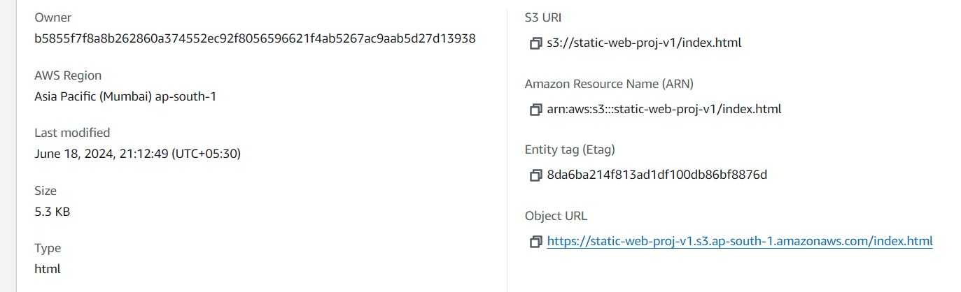
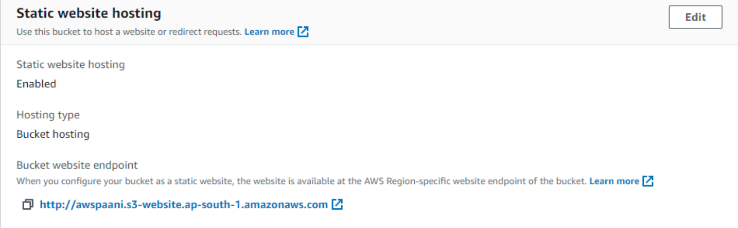
Enabling Static Website Hosting on S3
Access the Website URL
After enabling Static Website Hosting on S3, access your website via the URL provided in the "Static website hosting" tab of your bucket's Properties page. You can share this URL with others for public access to the website.

Slide 9


Error Page
You should also create a custom error page to display a personalized message in case of errors. This can be done by creating an HTML document and uploading it to your S3 bucket, then referencing it in the error document field of the Properties tab. Additionally, ensure that the appropriate permissions are set to allow public access to the error page.
Click here to view Error Page

